Slide 1
HMC Trade offers multi-investment platform services in fintech, precious metals, forex, and blockchain based trading platform as services.
Our multi-investment platform is designed to help users diversify their portfolios and take advantage of a range of investment opportunities in the fintech, precious metals, forex, and blockchain sectors.
Join Us !
Now !

Slide 2
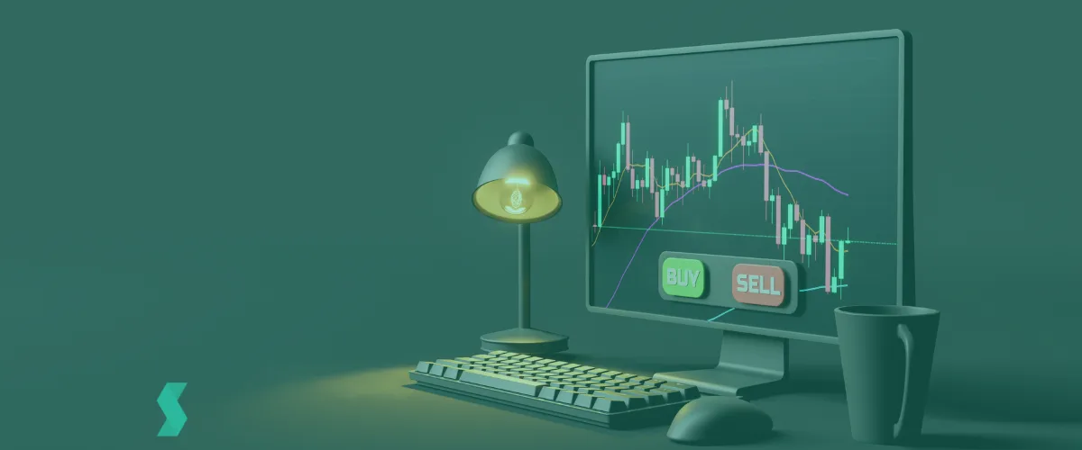
Choose the Right Platform for you to Trade
Desktop Platform
Mobile Platform
Downloadable trading software for advanced traders with customizable features and real-time data analysis
Trading on-the-go with the trading app for iOS and Android devices
Web-Based Platform
Social Trading Platform
Accessible from any browser with basic trading features and an intuitive interface for beginner traders
Connect with other traders, share strategies, and follow the most successful traders' trades
Experience seamless trading across multiple devices and connect with other traders with our multiplatform solution, featuring desktop, web, and mobile platforms, as well as a social trading platform

Slide 3
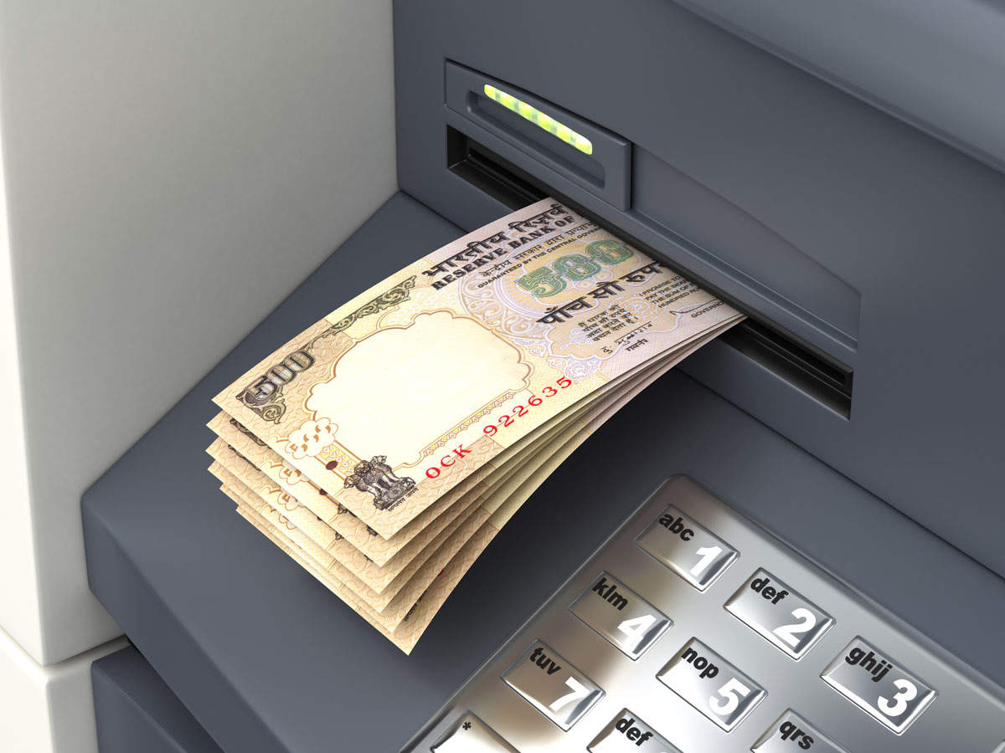
Welcome to Your Best Payment Gateway (Deposit & Payout)
PAYMENT PROCESSOR
MULTIPLE DEPOSITS AND WITHDRAWALS
“The Smartest way to Manage Your Online Finances”
We provide access to over 100++ payment gateways worldwide, as well as support for all major cryptocurrencies and tokens, ensuring convenient and secure payment options for our clients globally
You can choose one or several to make deposits and payouts to your trading accounts and wallets
https://coinbox.gitbook.io/harimau-mint/view-this-first/payment-gateway
We provide :
PayTrust88
ePayments
Coinify
Zaha
Perfect Money
B2BinPay
Mercuryo
Payeer
Yandex.Money
UPayCard
HotPay
Accentpay
Advanced Cash
AlgoGateway
PayPal
iPayTotal
MoonPay
MasterCard
9Pay
SafeCharge
Payza
VISA
Skrill
BitWallet
M-Pesa
FasaPay

Slide 4
Experience real-time trading with blockchain record-keeping for maximum transparency and security
COINS & TOKENS
10+
Main Cryptos
Bitcoin
XLM
Bitcoin Cash
BNB BSC
Ethereum
XRP Ripple
Dash
Litecoin
Zcash
Doge
TRX Tron
XMR
5+
Stable Coins
BUSD
DAI
TUSD
GRAM
USDT
PAXG
USDC
We understand the importance of flexibility in the world of cryptocurrency trading.
That's why we offer our clients the ability to deposit and withdraw funds using multiple crypto assets and tokens, providing unparalleled convenience and choice
BDDK
CBFI
BADGER
EDDK
SUSHI
AXS
SAND
FTM
1inch
CHZ
CAKE
BAND
ENJ
MATIC
LINK
BAT
BZRX
AAVE
MANA
REEF
UNI
SXP
30+
Tokens TRC20, BEP20 & ERC20

Slide 5
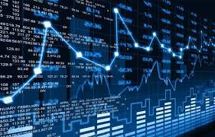
TRADING ASSETS
With our platform, you can access multiple trading instruments and take advantage of market opportunities around the clock
103+
(FOREX)
buying and selling of currencies
118+
(Shares CFDs)
financial product that allows traders to speculate on the price movements of an underlying asset
151+
(Crypto CFDs)
allow traders to speculate on the price movements of cryptocurrencies
CHF/JPY
CADUSD
GBP/USD
AUD/JPY
EUR/USD
USD/JPY
AUDCAD
EUR/JPY
NZD/USD
TRY/JPY
EUR/GBP
AUD/USD
Adidas
Airbus Group
Nestle
Xiaomi
Netflix
Volkswagen
Bank of China
BNP Paribas
Walt Disney
Meta Platforms
FedEx
Ford Motor
Nike
Tesla
Nvidia
Bank of America
Amazon
Exxon Mobile
Citigroup
Boeing
Coca-Cola
McDonalds
Microsoft Corporation
Binance
Bitcoin
Ethereum
Dogecoin
Ripple
TRON
MATIC
Arbitrum
13+
(Indices)
group of stocks that represent a particular market or sector that allows traders to invest in a broader range of stocks
10+
(Metals)
invest in commodities that have historically held value and can provide a hedge against inflation
2+
(Energies)
invest in the global energy market and potentially profit from changes in supply and demand
Hong Kong 50 Index
Germany 40 Index
UK 100 Index
Switzerland 20 Index
EURO 50 Index
Japan 225 Index
DJIUSD
SILVER
GOLD
PALLADIUM
PLATINUM
COPPER
CRUDE OIL
NATURAL GAS
Unleash your trading potential with our platform. With multiple trading instruments and 24/7 access, you'll never miss an opportunity

Slide 6
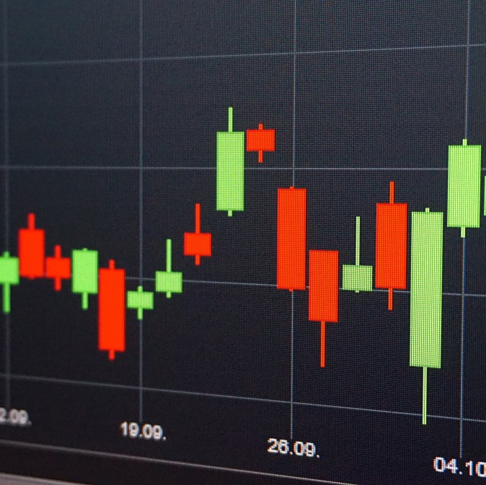
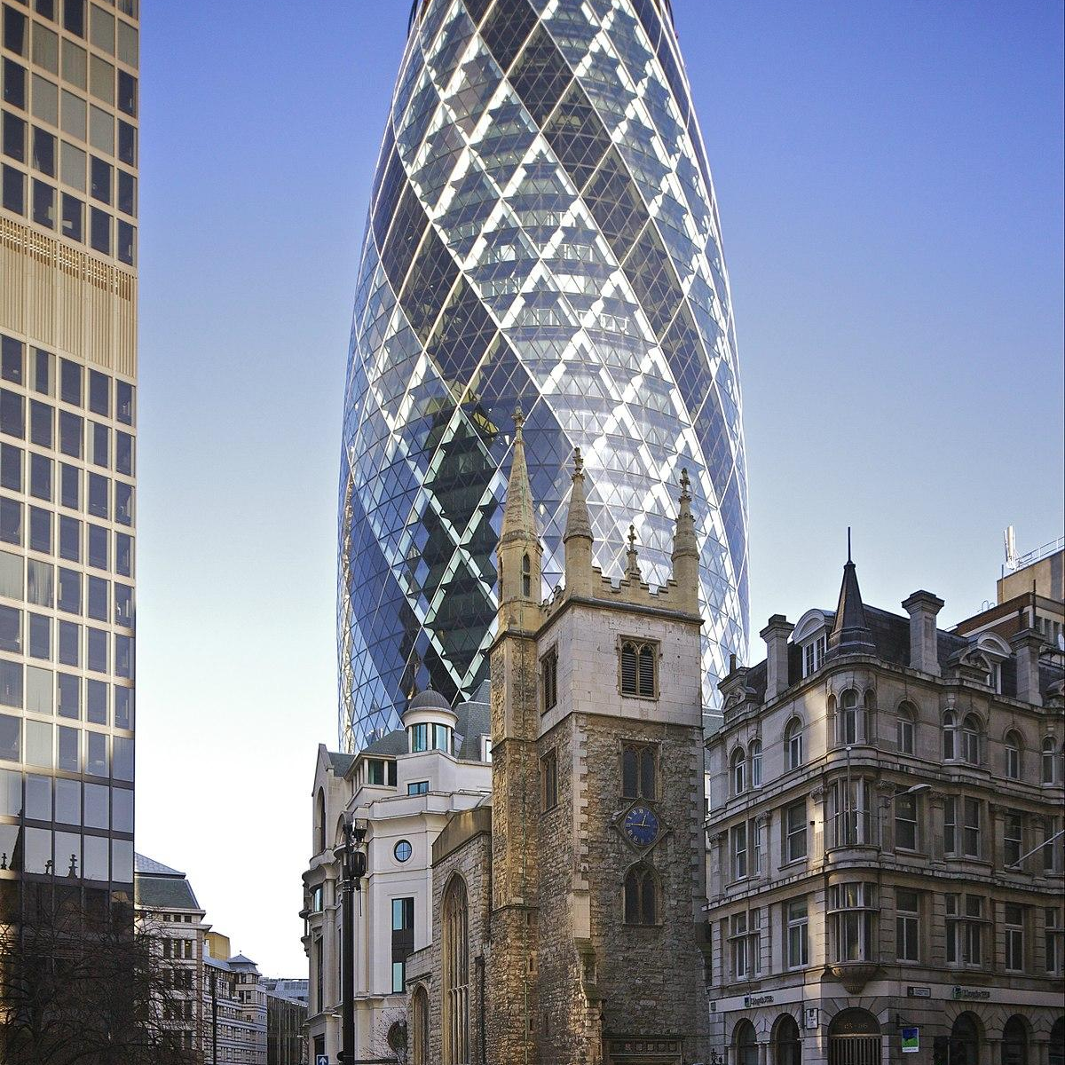
OUR PRODUCTS
Physical Gold Metals
Digital Gold Saving Account
Digital Gold Convert Account
Digital Gold Asset Enhance
24K 999.9 for 0.1 Gram and 1 Gram (Wide Design)
Allows you to invest in gold without the hassle of physical storage or the need to buy and sell large amounts at once
Offers flexibility and the ability to quickly convert your gold holdings into cash or other currencies as needed
DGAE
REMARK
Multi Asset Enhance
Proprietary Trading
CityScape Lifestyle
Copy Trading Platform
Choose from our Standard, ECN, and CENT accounts, with leverage ranging from 1:10 up to 1:1000, and trade with the MT4 and cTrader platforms
Join our trading platform and get up to $400,000 in funding through our selection process
Transform your investments with our NFT marketplace and real estate tokenization platform
Our copy trading platform allows you to mirror top-performing traders and achieve your financial goals

Slide 7
LEGALS
We are proud to be licensed by two regulatory bodies that oversee financial services in their respective jurisdictions.
These regulatory bodies are;
DUBAI DMCC
Government entity that regulates and licenses businesses in the commodities sector, including precious metals
LABUAN LOFSA
Regulatory body that oversees financial services in Labuan, including banking, insurance, and securities
By holding licenses from these regulatory bodies, we are able to operate our platform in a way that is compliant with their regulations and standards, providing our users with added confidence and trust in our platform, knowing that we are operating in a transparent and regulated manner.

Slide 8
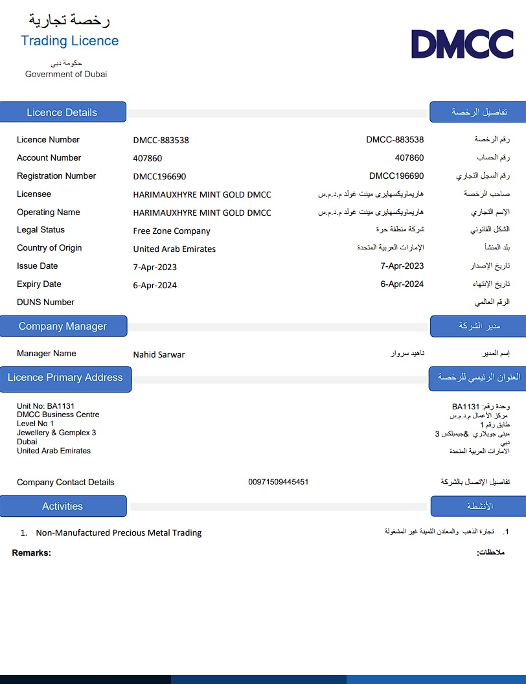
OUR LICENSES
These are our trading licenses acquired from Dubai DMCC;
a)
b)
a) Non-Manufactured Precious Metal Trading
Licence
Authorized to trade non-manufactured precious metals through a license obtained from DMCC
Allows us to buy, sell, and store valuable metals like gold, silver, platinum, and palladium
b) Trading for Proprietary on Regulated Exchanges (DMCC)
Enables us to participate in the buying and selling of various financial instruments, such as stocks, bonds, commodities, and derivatives, on established and regulated trading platforms

Slide 9
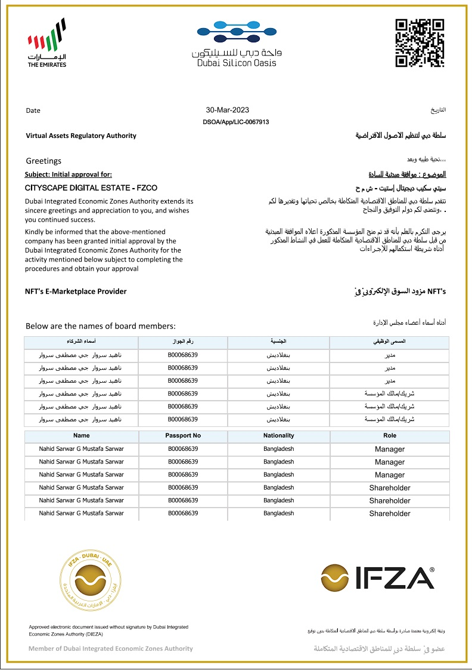
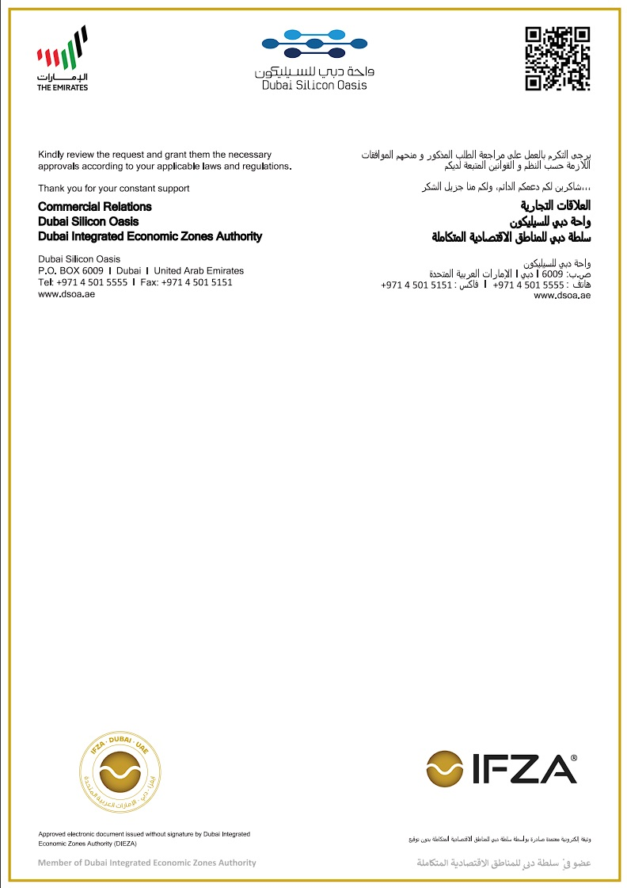
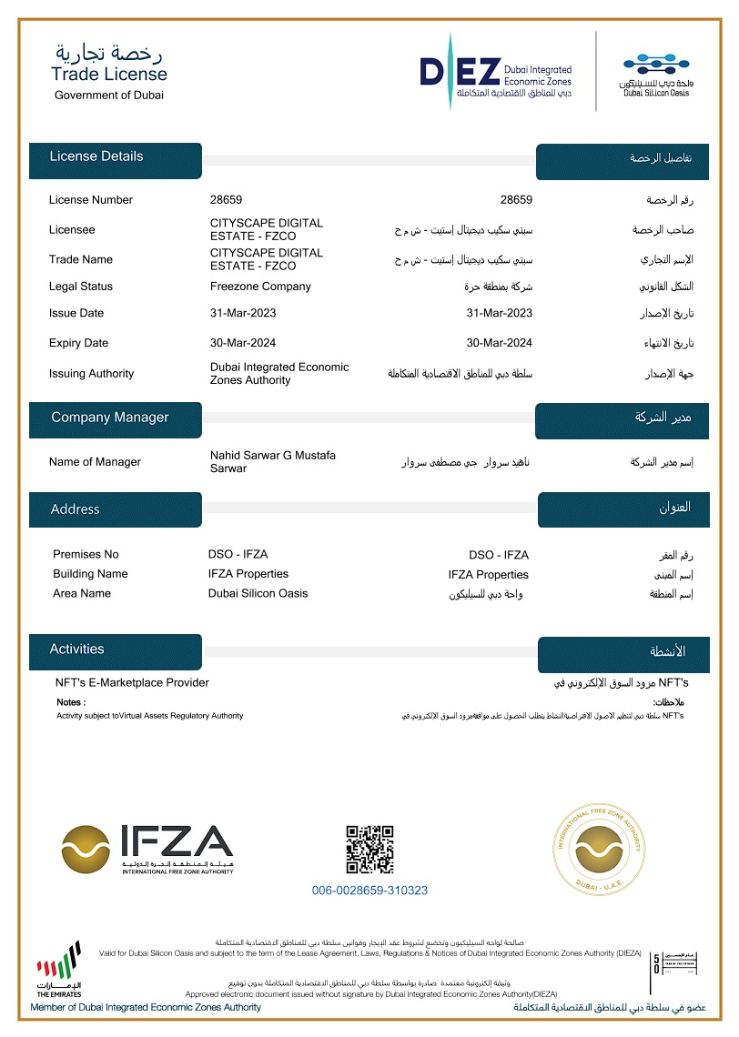
c) NFT’s E-Marketplace Provider (DSOA & DEZ)
Granted by Dubai Silicon Oasis Authority (DSOA) and Dubai Integrated Economic Zones Authority (DEZ) for virtual asset trading within the Dubai Silicon Oasis free trade zone.
c)

Slide 10
OUR PARTNER & PROVIDERS
We're dedicated to delivering the best user experience, and will collaborate with partners and fintech providers to offer cutting-edge products. Stay tuned for more exciting developments

Slide 11
CONTACT US HERE
💬 Harimau Mint Capital Important Links :
Official Website : ( https://www.harimaumint.com )
Gitbook Info : ( https://coinbox.gitbook.io/harimau-mint/ )
Medium Blog : ( https://medium.com/@harimaumintcapital )
Office and Centres
London : +447774569174
Dubai : +034 123 - 4567 - 6613
Kuala Lumpur : +60128118016
+60176852602
Harimau Mint Capital Social Media :
Twitter : ( https://twitter.com/HarimauMint )
Facebook : ( https://www.facebook.com/harimaumintcapital/ )
Youtube : ( https://www.youtube.com/@harimaumintcapital )
Linkedin: ( https://www.linkedin.com/company/harimau-mint-capital/ )
Telegram Channel : ( https://t.me/harimaumint )
Telegram Group : ( https://t.me/harimaumintgroup )
TikTok : ( https://www.tiktok.com/@harimaumint )
Instagram : ( https://www.instagram.com/harimaumintcapital )
Email and SKYPE Support
: support@harimaumint.com
SKYPE
: Daustrader

Slide 12
Contact Us
We wanted to take a moment to express our sincere gratitude for your support of our platform. Your contributions have been instrumental in helping us to build a robust and innovative platform that offers a range of investment options to our users.
Read More

